Slide 1
Statistical Reasoning
Course Code: CSC4226
Course Title: Artificial Intelligence and Expert System
Dept. of Computer Science
Faculty of Science and Technology
Lecture No: | Ten (10) | Week No: | Eleven(11) | Semester:
Lecturer: | SAZIA SHARMIN

Slide 2
Lecture Outline
Quantifying Uncertainty
Basic Probability Notation
Bayes’ Rules and Its Use
Clinical Trials
The Semantics of Bayesian Network
Prediction in Bayesian Network

Slide 3
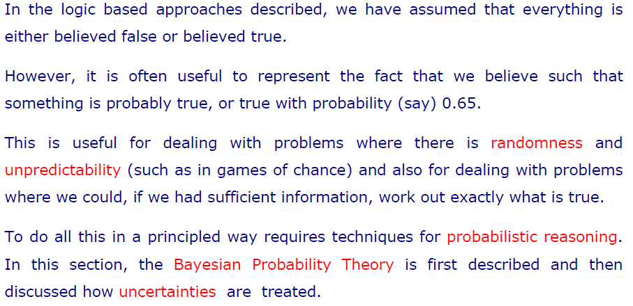
Quantifying Uncertainty

Slide 4
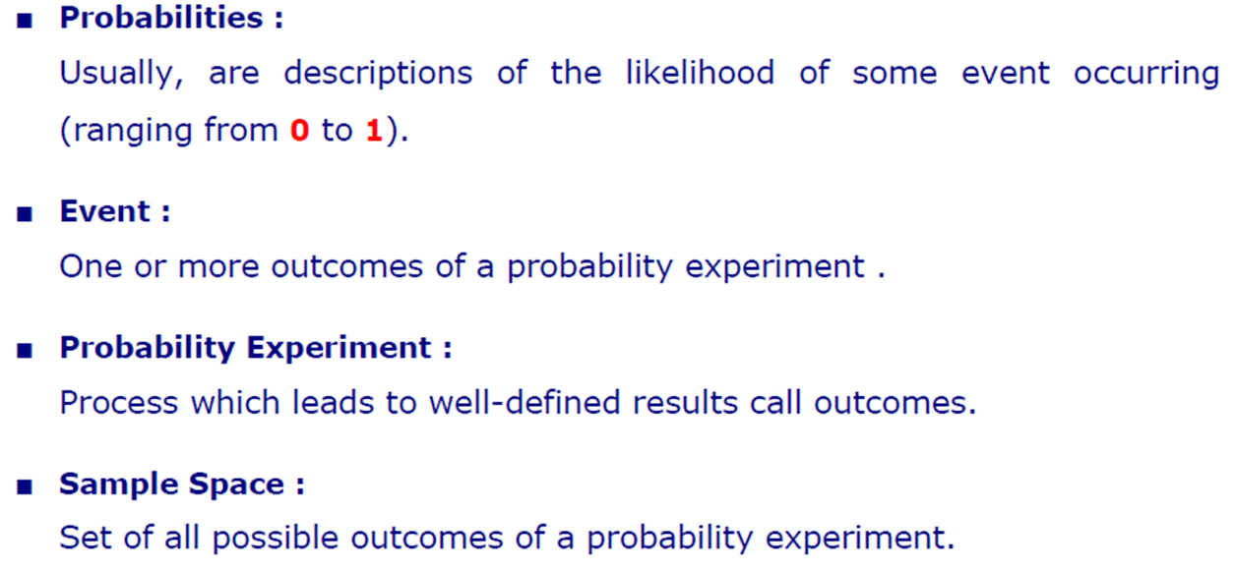
Basic Probability Notations

Slide 5
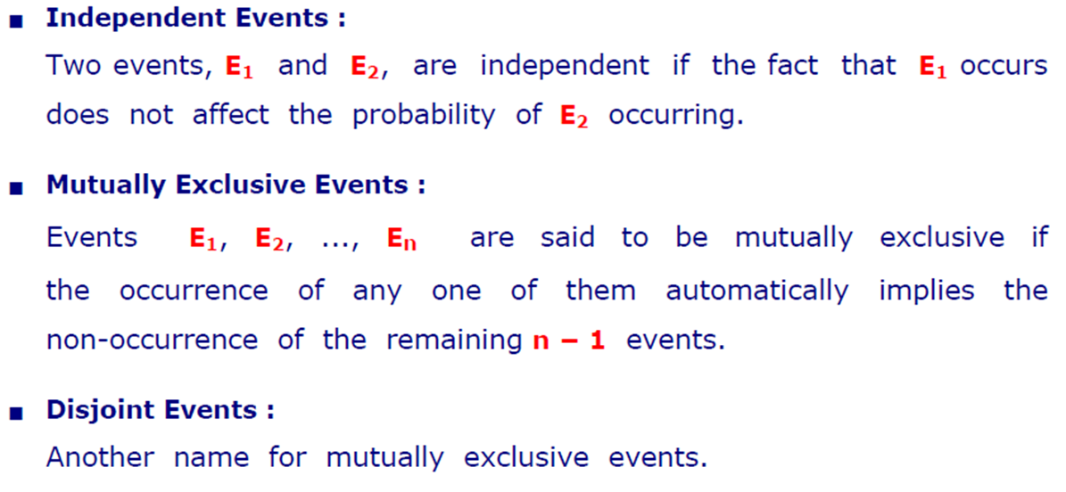
Basic Probability Notations

Slide 6
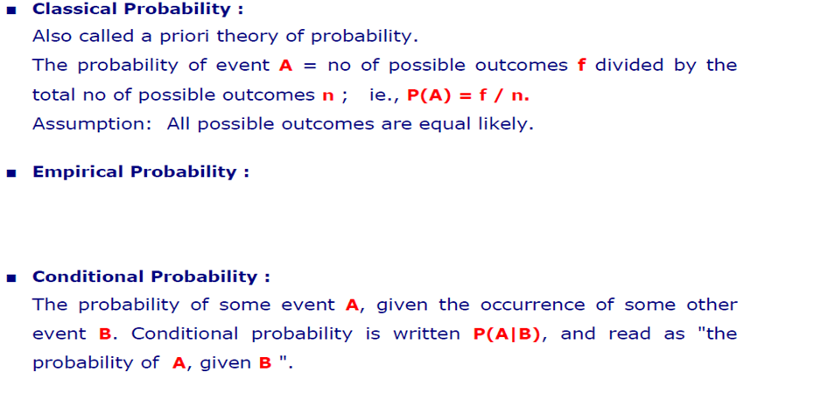
Basic Probability Notations
Empirical probability, also known as experimental probability, refers to probability that is based on historical data. In other words, empirical probability illustrates the likelihood of an event occurring based on historical data.

Slide 7
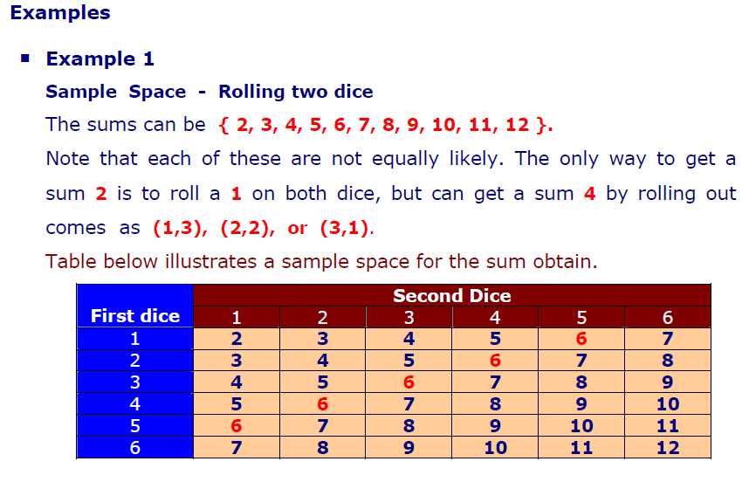
Examples

Slide 8
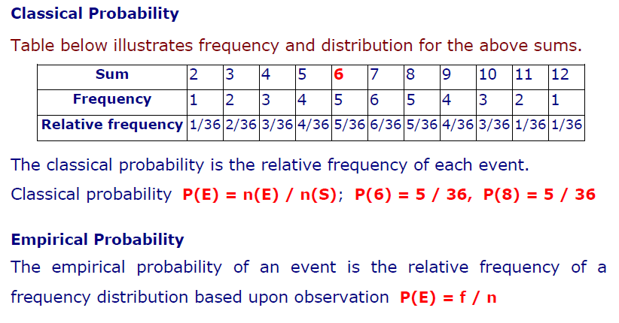
Classical & Empirical Probability

Slide 9
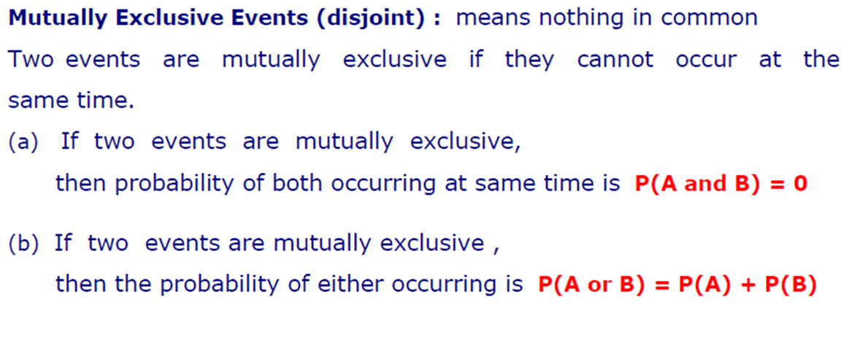
Disjoint Events

Slide 10
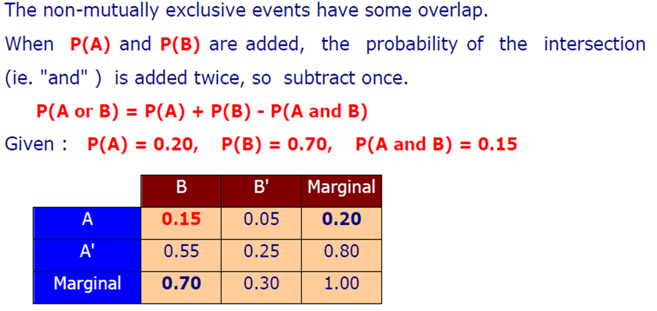
Non-Mutually Exclusive Events

Slide 11

Mutually Exclusive vs Non-Mutually Exclusive Events
Mutually Exclusive
Non-Mutually Exclusive
A
B
A
B
A $∩B$

Slide 12
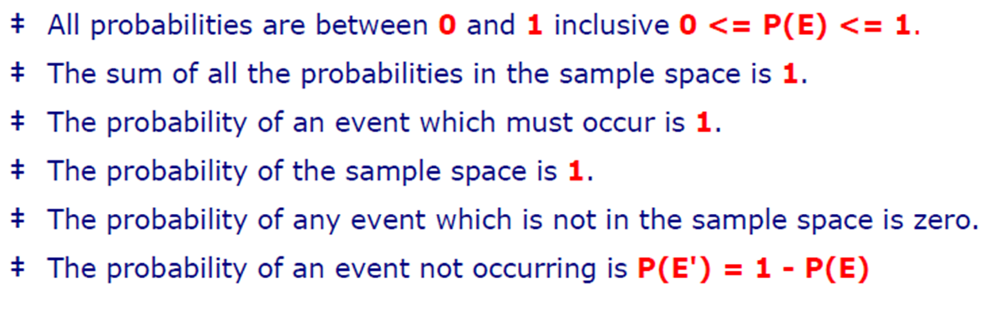
Probability Rules

Slide 13
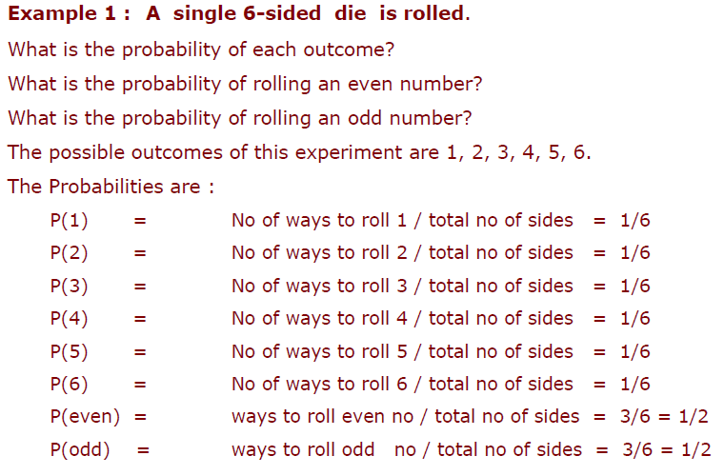
Practice 1

Slide 14
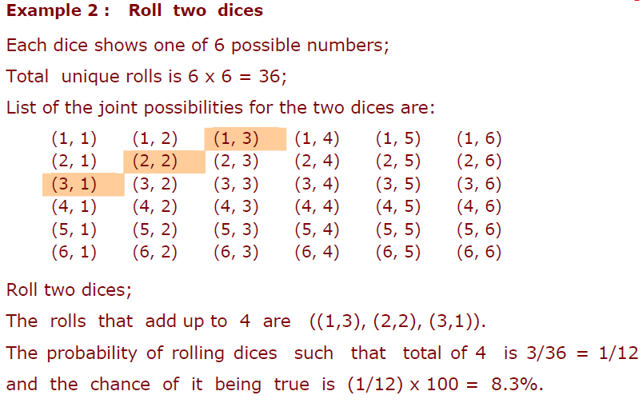
Practice 2

Slide 15
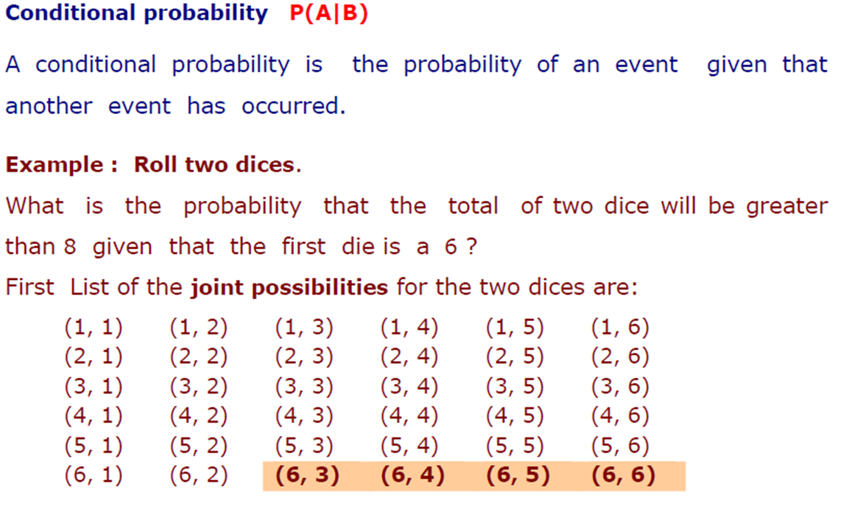
Conditional Probability

Slide 16
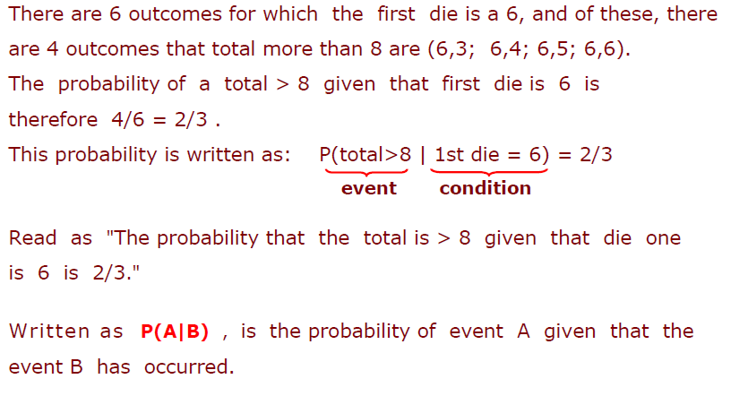

Slide 17
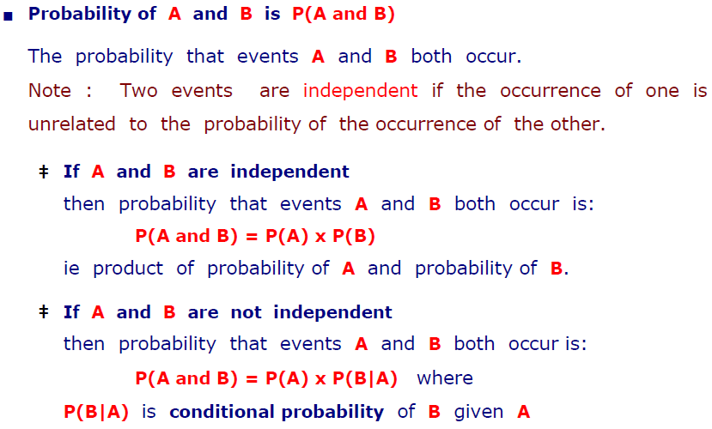
Joint Probability

Slide 18
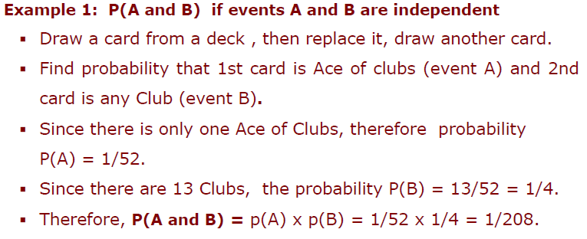
Joint Probability : Independent Events

Slide 19
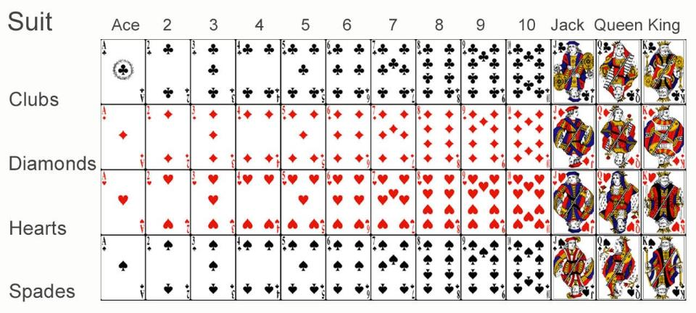
Joint Probability : Independent Events

Slide 20
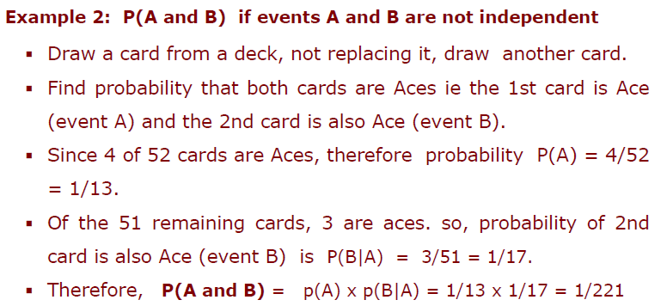
Joint Probability : Dependent Events

Slide 21
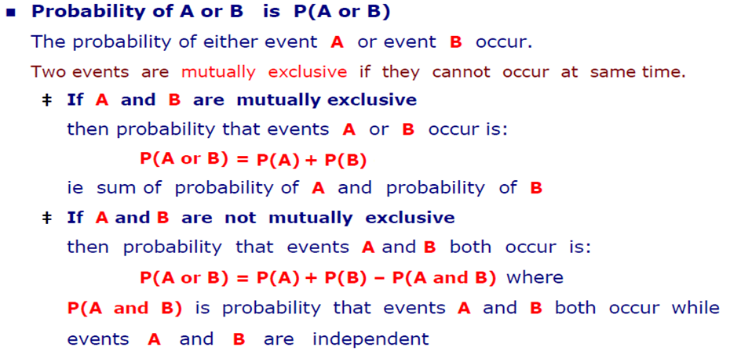
OR Operation

Slide 22
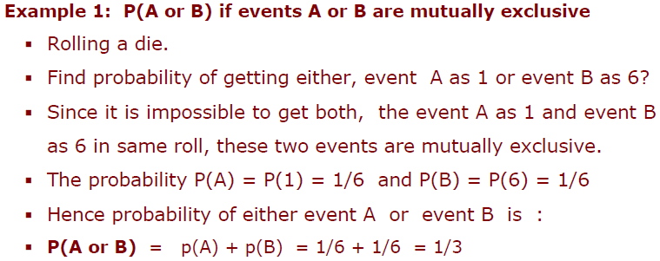
OR Operation: Mutually Exclusive

Slide 23
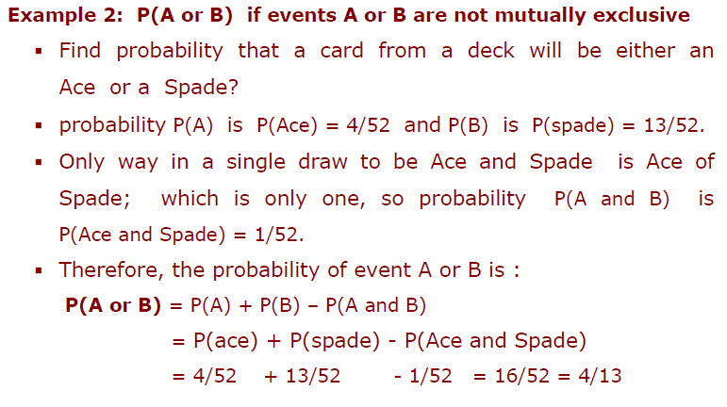
OR Operation: Not Mutually Exclusive

Slide 24
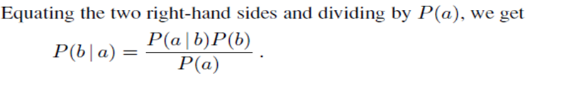
Bayes’ Rule
Product rule can be written in two forms
This equation is known as Bayes’ rule (also Bayes’ law or Bayes’ theorem).
This simple equation underlies most modern AI systems for probabilistic inference.

Slide 25
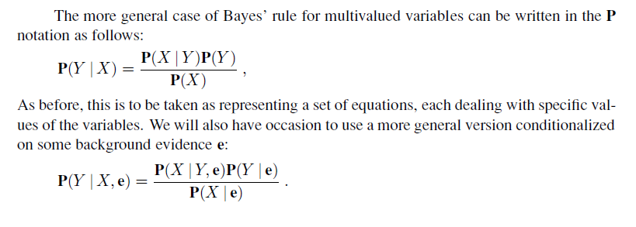
General Case of Bayes’ Rule

Slide 26
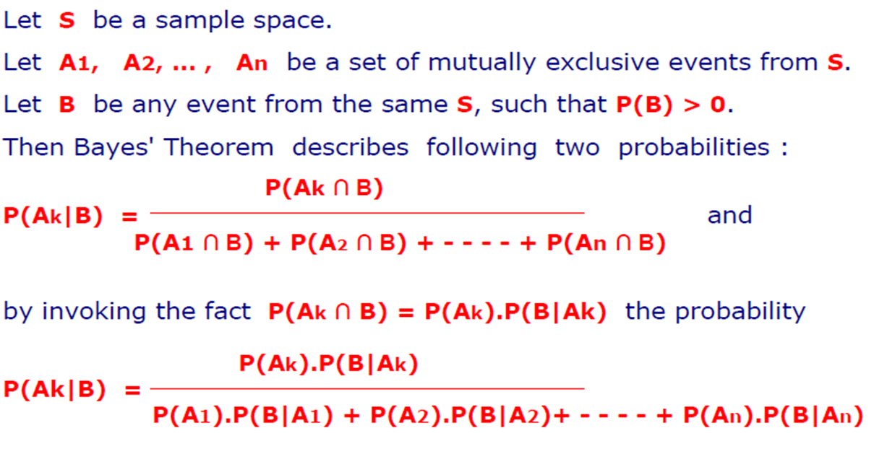
Bayes’ Theorem: Revisited

Slide 27

Applying Bayes’ rule: The simple case
The conditional probability P(effect | cause) quantifies the relationship in the causal direction,
whereas P(cause | effect) describes the diagnostic direction
In a task such as medical diagnosis, we often have conditional probabilities on causal relationships (that is, the doctor knows P(symptoms | disease)) and want to derive a diagnosis, P(disease | symptoms).

Slide 28
Exercise
Two bags are there containing Green and Blue balls, first bag has 3 green and 2 blue balls, second bag has 2 green and 3 blue balls. One ball is drawn randomly. Find the probability that is Green ball?
Without any biasing one bag is chosen from that one ball is chosen randomly which was green. What is probability that is came from the second bag?

Slide 29
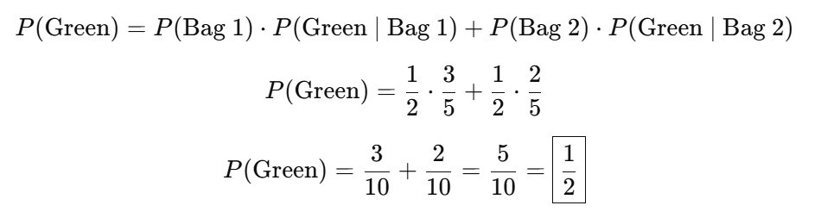
Exercise

Slide 30
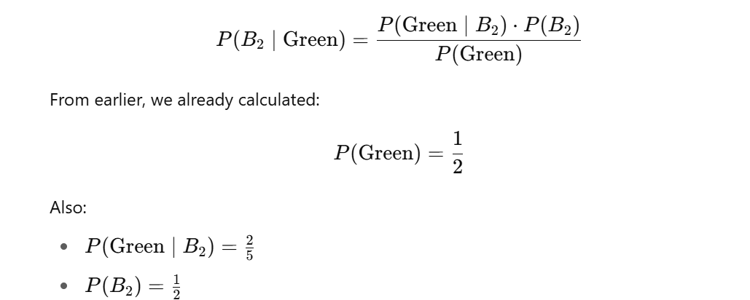
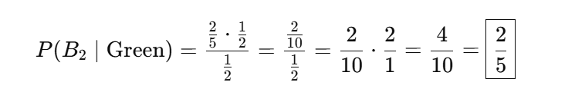
Exercise

Slide 31
Exercise

Slide 32
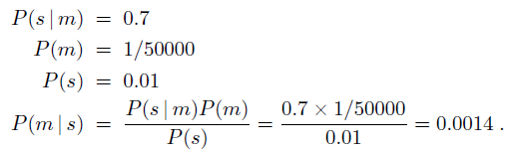
Applying Bayes’ rule: A Simple Example
A doctor knows that
the disease meningitis causes the patient to have a stiff neck, say, 70% of the time.
The doctor also knows some unconditional facts: the prior probability
that a patient has meningitis is 1/50,000,
and the prior probability that any patient has a stiff neck is 1%.
Letting
s be the proposition that the patient has a stiff neck and
m be the proposition that the patient has meningitis, we have

Slide 33
Exercise
In a neighbourhood, 90% children were falling sick due flu and 10% due to measles and no other disease. The probability of observing rashes for measles is 0.95 and for flu is 0.08. If a child develops rashes, find the child’s probability of having flu.

Slide 34
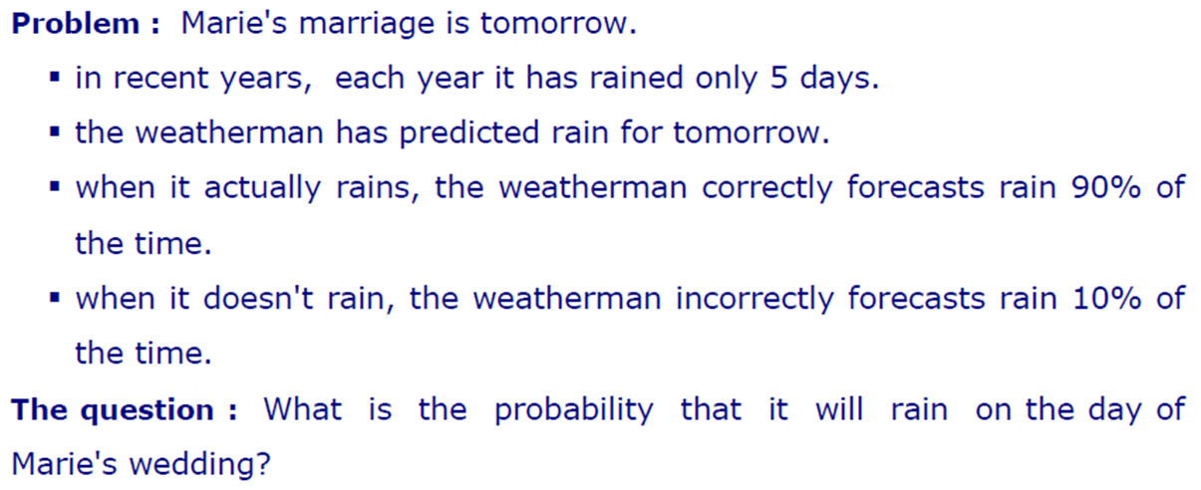
Another Example

Slide 35
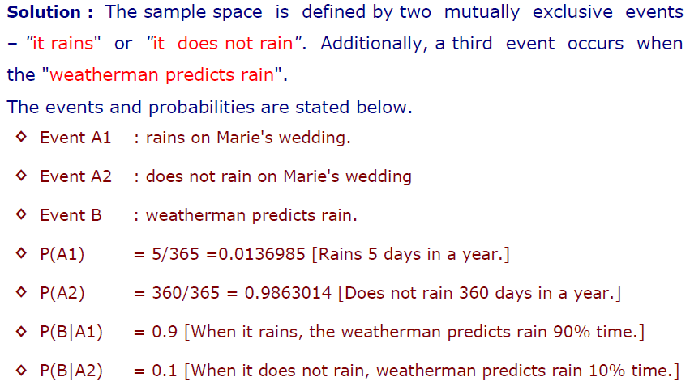
Solution

Slide 36
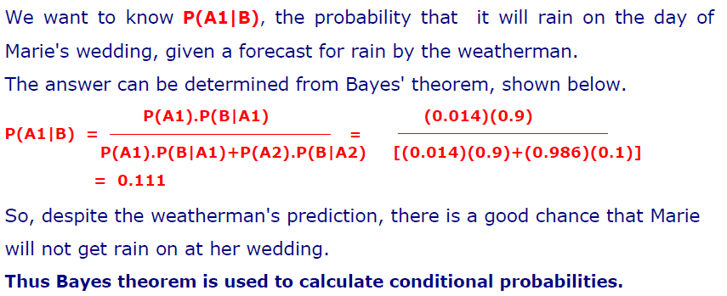
Calculation

Slide 37
Exercise
Three persons A, B and C have applied for a job in a private company. The chance of their selections is in the ratio 1 : 2 : 4. The probabilities that A, B and C can introduce changes to improve the profits of the company are 0.8, 0.5 and 0.3, respectively. If the change does not take place, find the probability that it is due to the appointment of C.

Slide 38
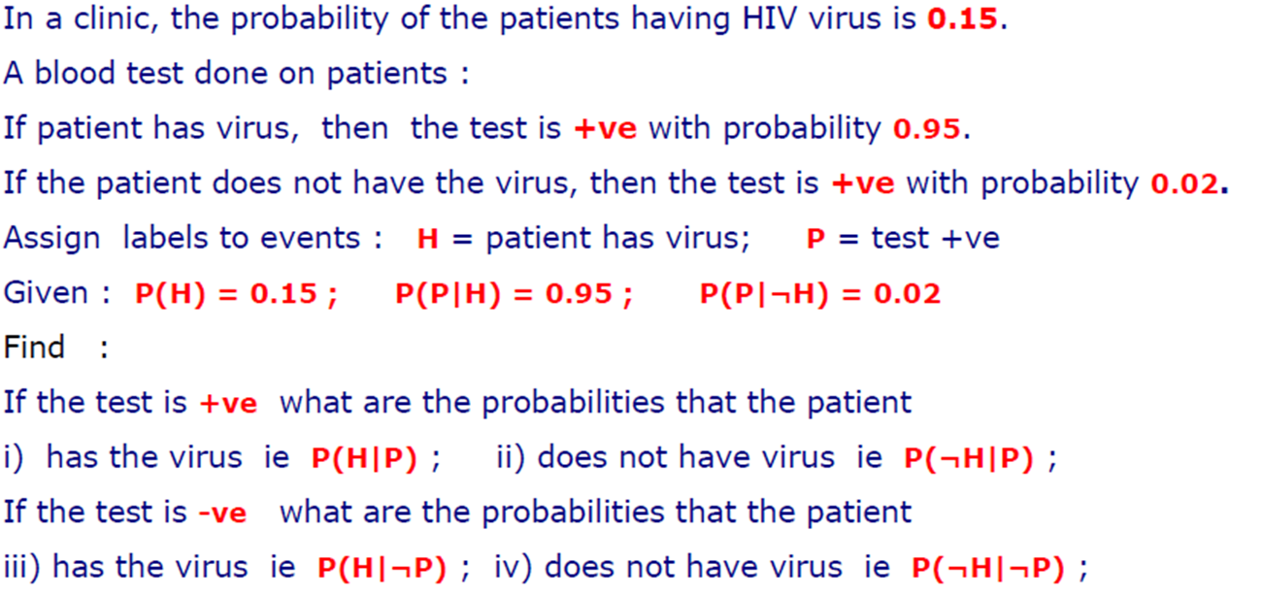
Example: Clinical Trial

Slide 39
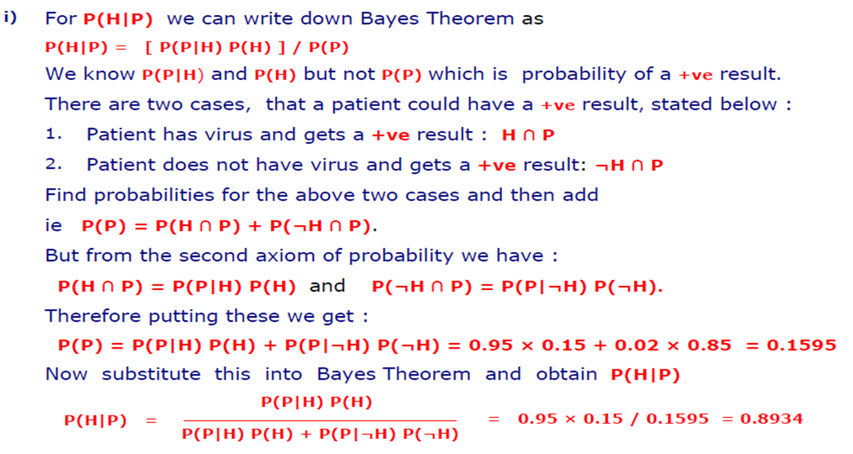
Calculations

Slide 40
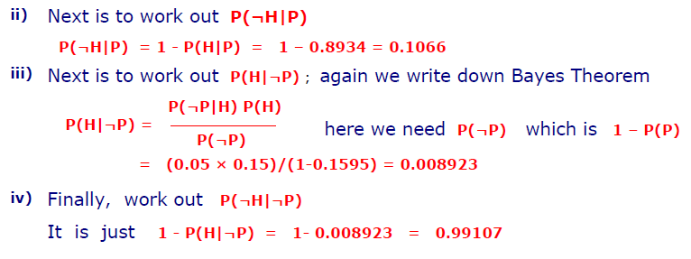
Calculations

Slide 41
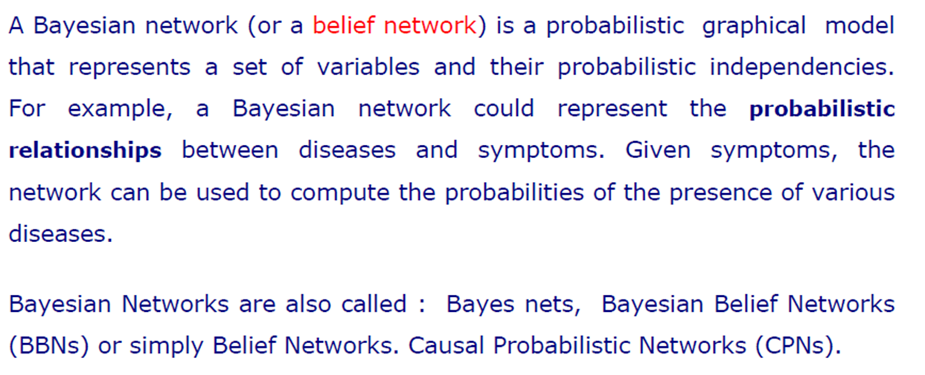
Bayesian Networks

Slide 42
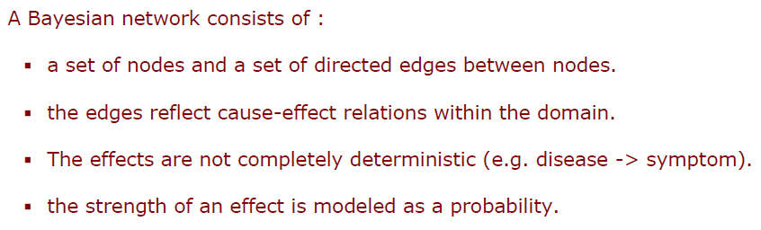
Components of Bayesian Network

Slide 43
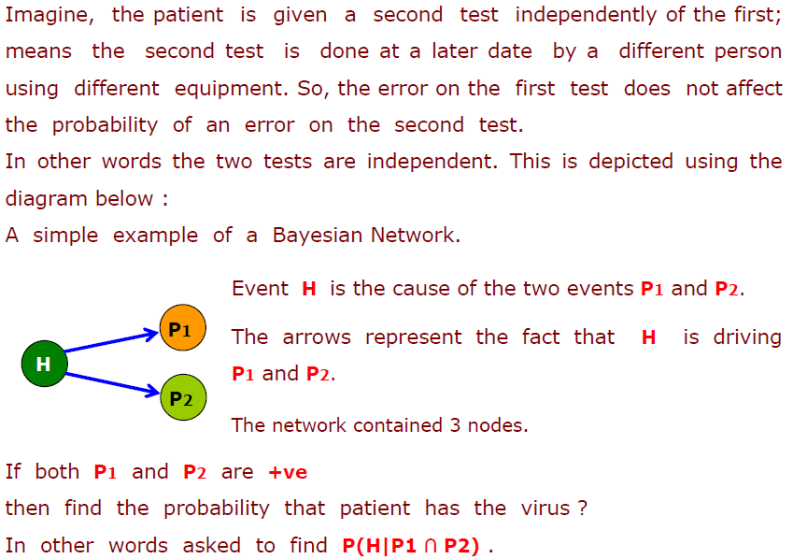
Bayesian Network: Clinical Trial Example

Slide 44
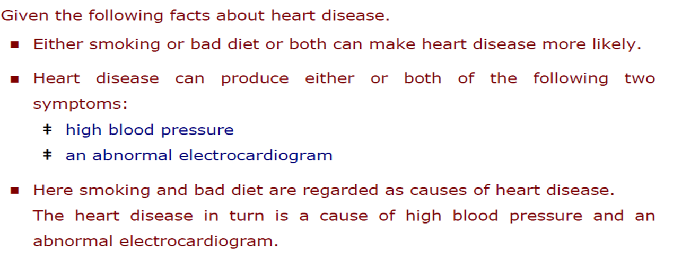
Complicated Bayesian Network

Slide 45
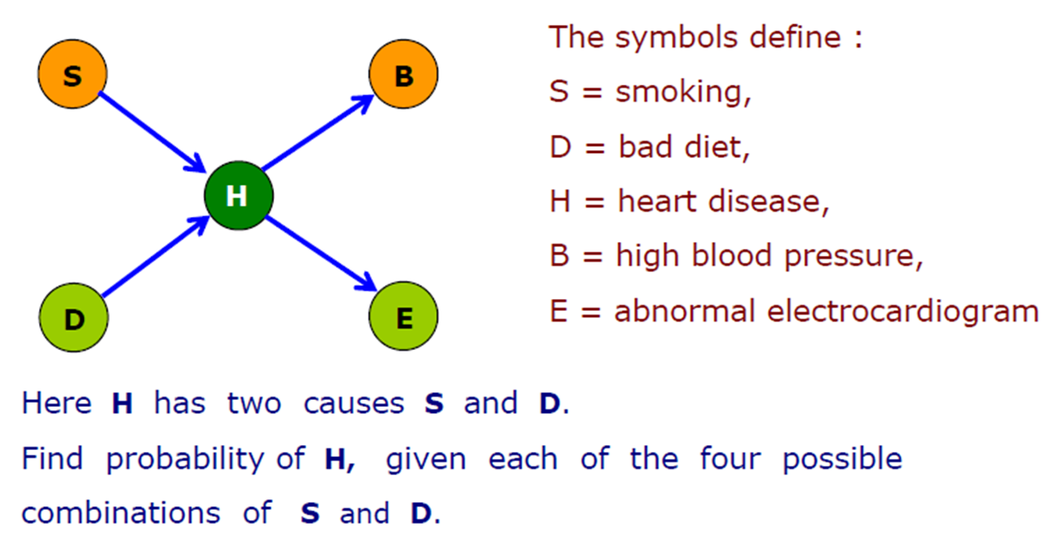
Network of Heart Disease

Slide 46
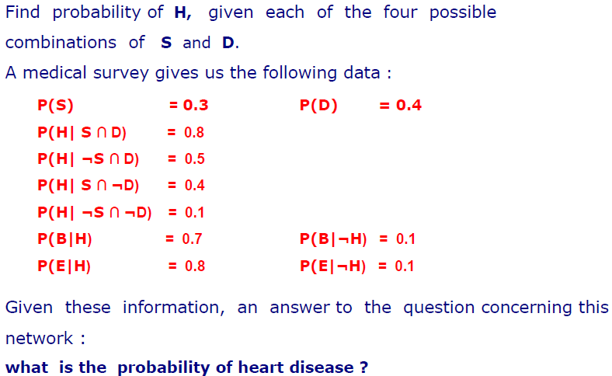
Practice Question

